Slide 1
Sezmi
Trident Technical college course registration

Slide 2
What is a programmer's favorite language?

Slide 3
What is a programmer's favorite language?
Profanity

Slide 4

Introductions: Jeremy Hunton
Before Jeremy enrolled in Trident's Computer Programming major, he was a career musician and music teacher. Besides graduating this year, he is excited about getting to marry his fiancé, Brea, this upcoming Saturday in Asheville.

Slide 5


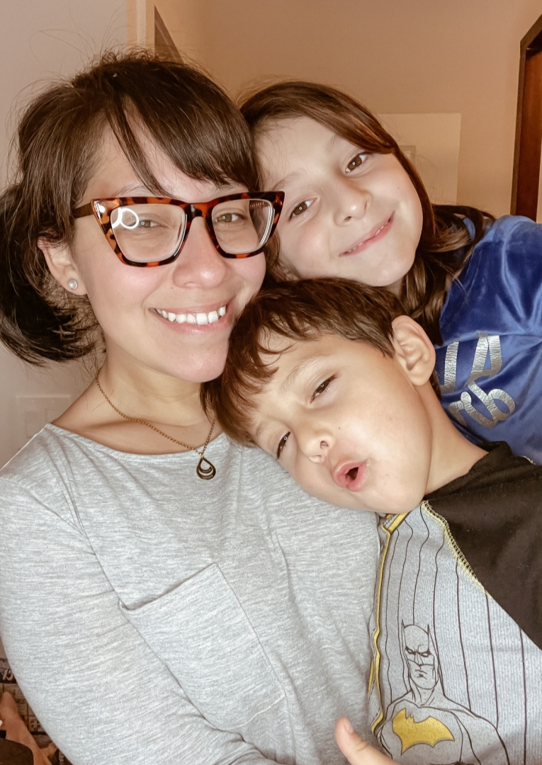
Ariana Konhilas
After working in the food and beverage industry for far too long, Ariana realized it was time for a change. She took a chance on a little school called Trident and her life was changed forever. On day one of her first class she couldn't believe her eyes. It was THEE Tom Brady! From that day forward he was always on her side, supporting her from the sidelines.
It hasn't always been an easy ride, there were often times of blood, sweat, and many, many tears, but it was worth it. Welcome to my superbowl and thank you all for everything.

Slide 6

Billy stockton
Hello, my name is Billy Stockton
If I had to say what defines me it could be summed up in 2 words, faith and family, which are the two most important things in my life. I have been married for over 30 years and have 2 daughters, one is a nurse and the other about to graduate from Charleston Southern University. I consider it an honor to be graduating at the same time as her.
That being said, I love a challenge and love to problem solve which led me to pursue a career change to programming at this juncture of my life. To be perfectly honest, I was not entirely sure I would ever be at the point of graduation. I owe a lot to my family for their encouragement and patience but also to Professor Jackson and the rest of the Trident staff as well as my team members this semester. These people are amazing and will go on to do amazing things in the industry.

Slide 7
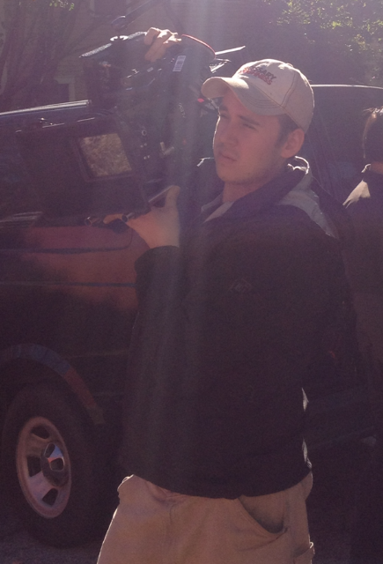
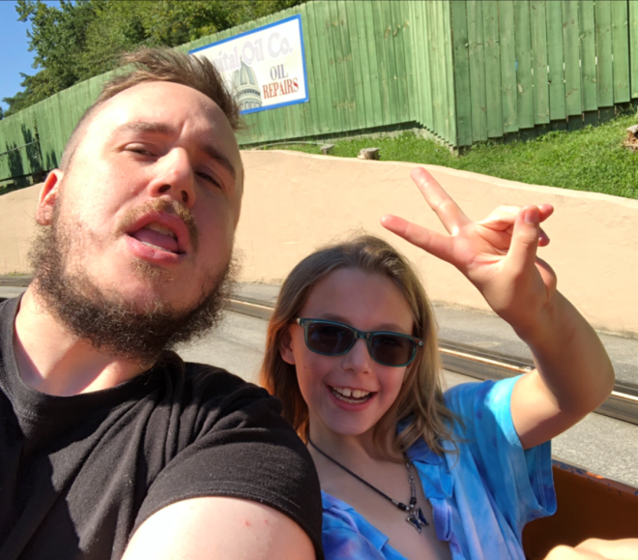
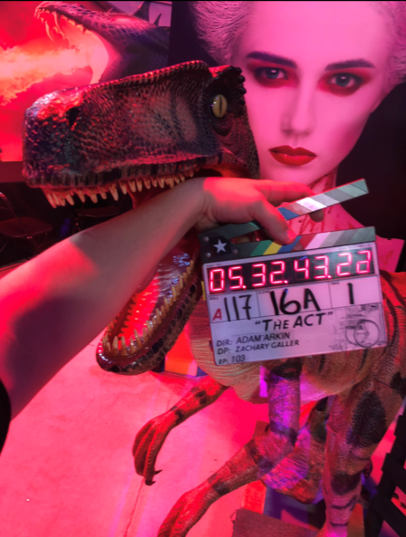
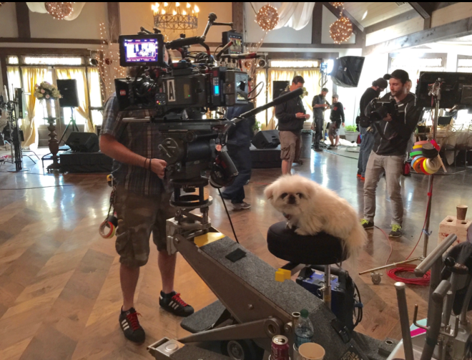
Aaron willis
Hi, My name is Aaron.
I have worked professionally in the camera dept. of various film productions for the past 10 years.
I have played guitar for the past 23 years.
I am an avid gamer and have played for the past 29 years
Now, I am an avid programmer and am very excited to share all that we have accomplished over the last 3 months with you all.

Slide 8
Mock course registration
Our goal was to bring simplicity and ease of use to the TTC student’s registration process by creating a website where students could choose their major and enroll in courses that they need for their major.

Slide 9

Product owner expectations
Reduce the need for a middleman/advisor
Login page
Choose a major
Courses needed
Courses taken
Filter by pre-requisites
Section selection and labeling

Slide 10

Approach
We met with Product Owner Bi-Weekly
Organized our ideas via Trello
Daily standup meetings
Clear communication
One step at a time

Slide 11
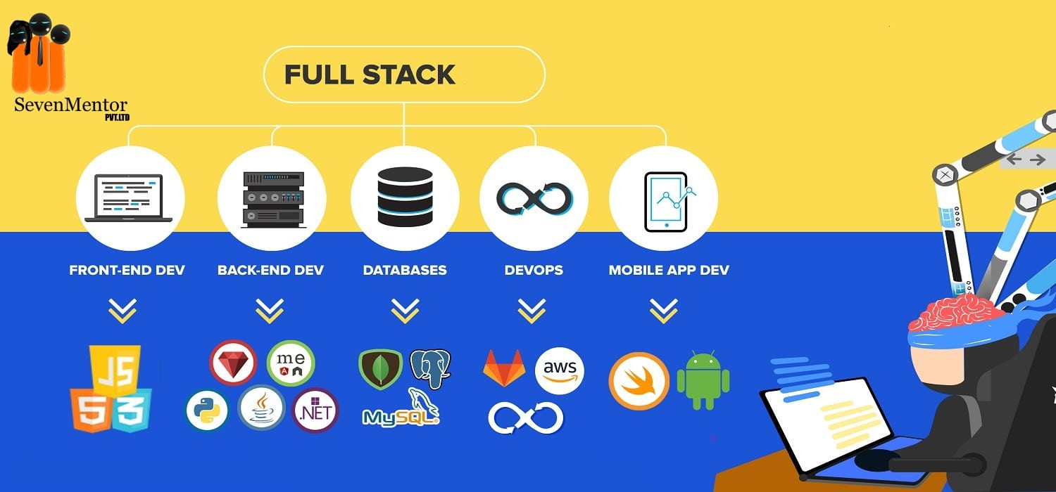
Architecture
Virtual machine
Data entry
Database design
Springboot
Java
Javascript/HTML/CSS

Slide 12

hurdles
Learning Springboot
Re-Learning Javascript
Sharing VM time
Git Hub from Command Line
Not defaulting to the familiar but challenging ourselves to learn the unknown and uncomfortable
Communication

Slide 13
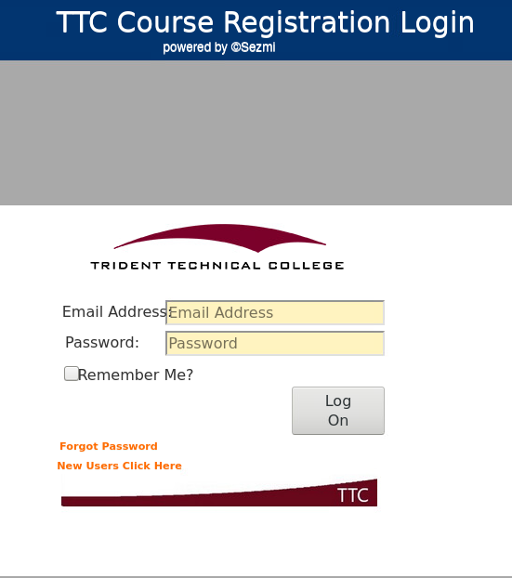
How it works
Login

Slide 14
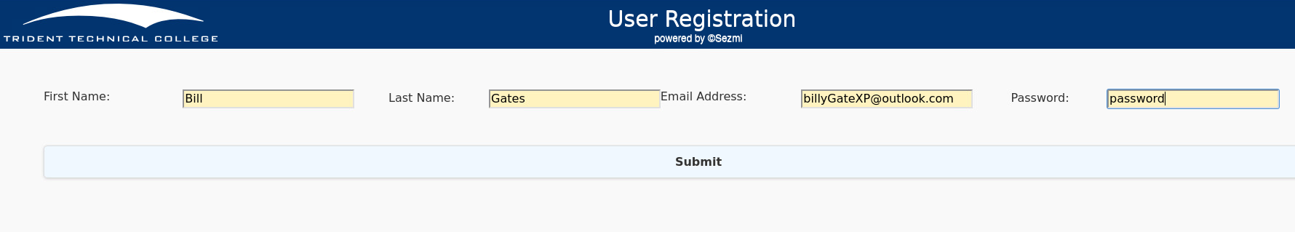
How it works
Create a user account

Slide 15
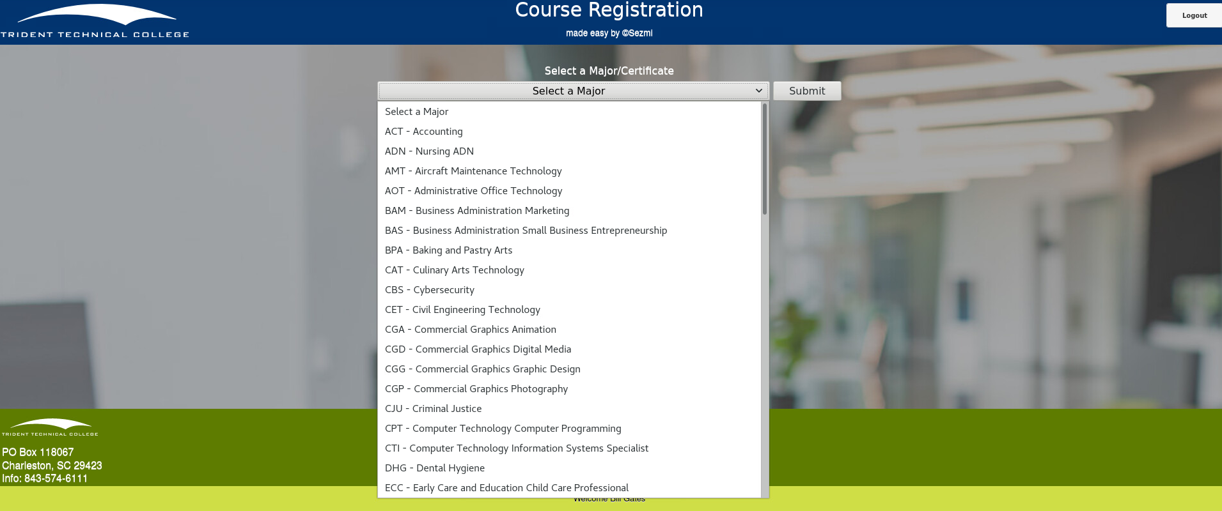
How it works
Select a major

Slide 16
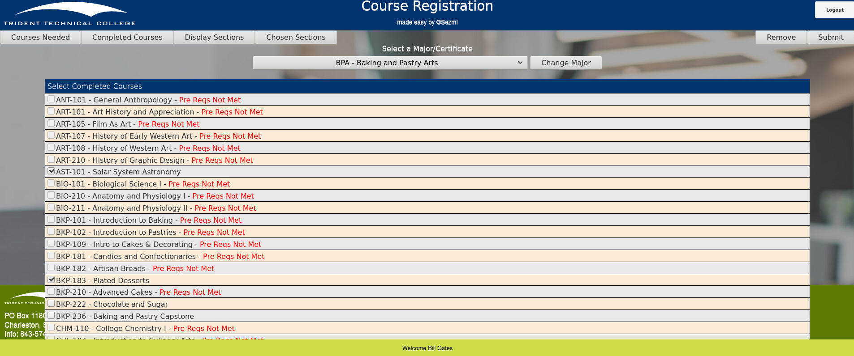
How it works
Add courses already taken

Slide 17
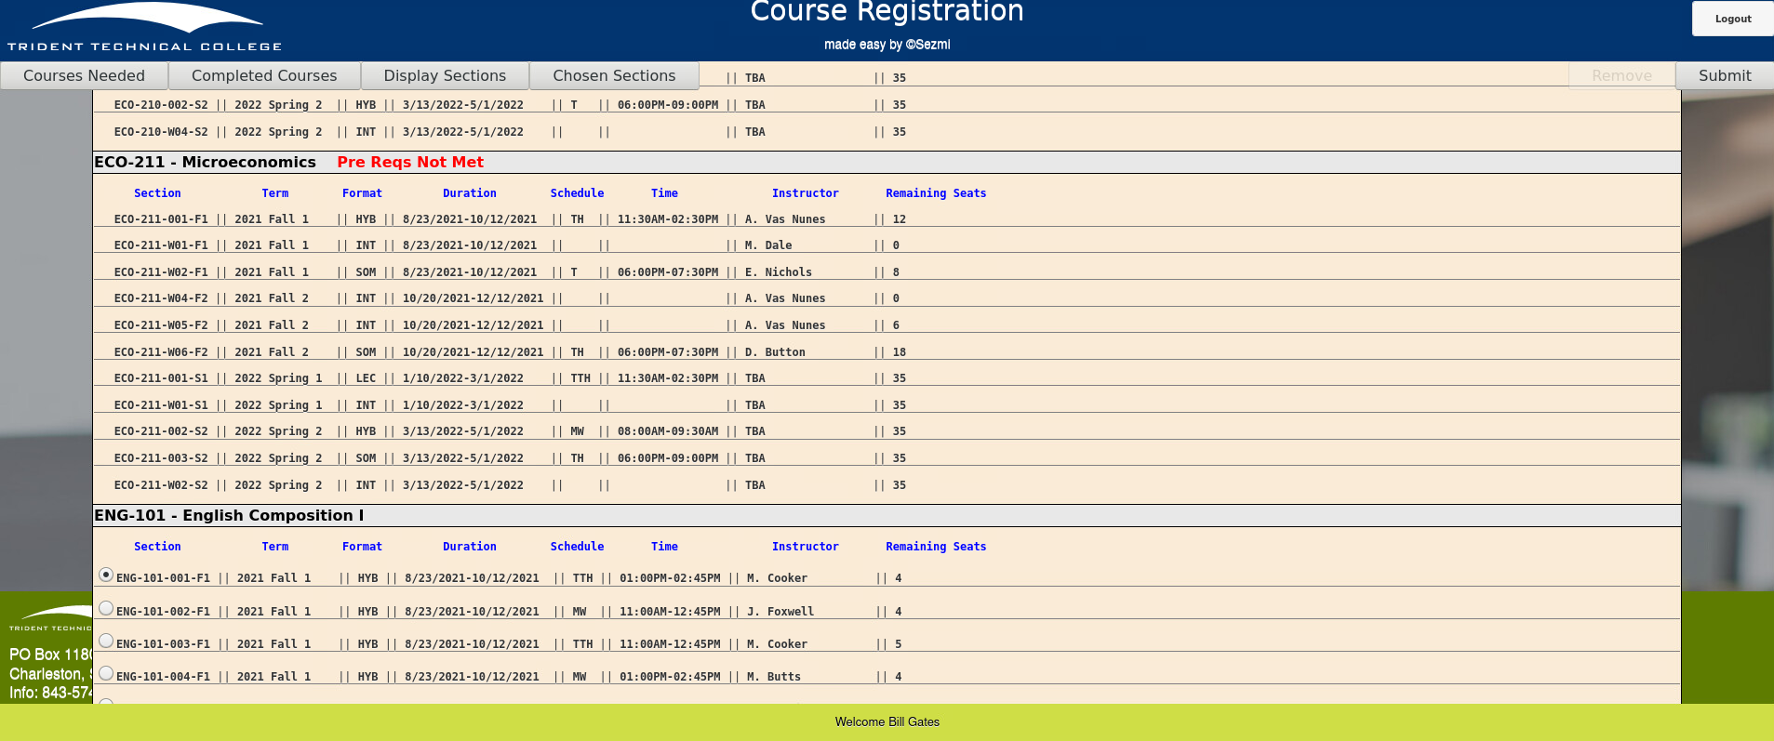
How it works
Add sections to take

Slide 18
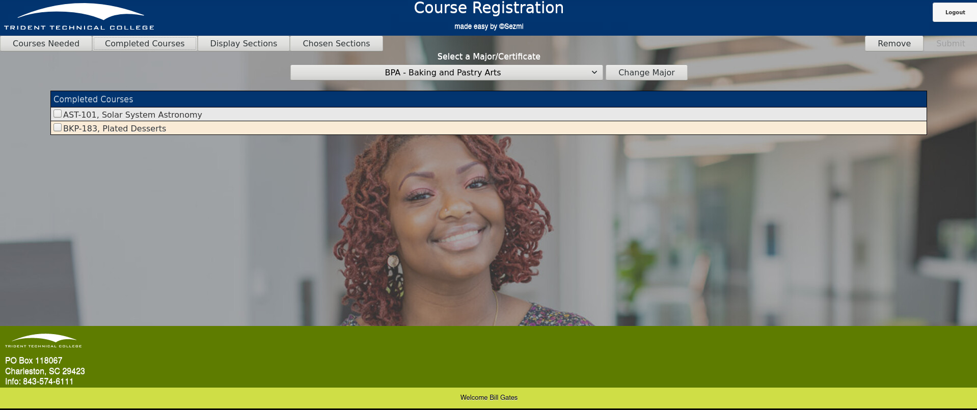
How it works
View courses taken

Slide 19
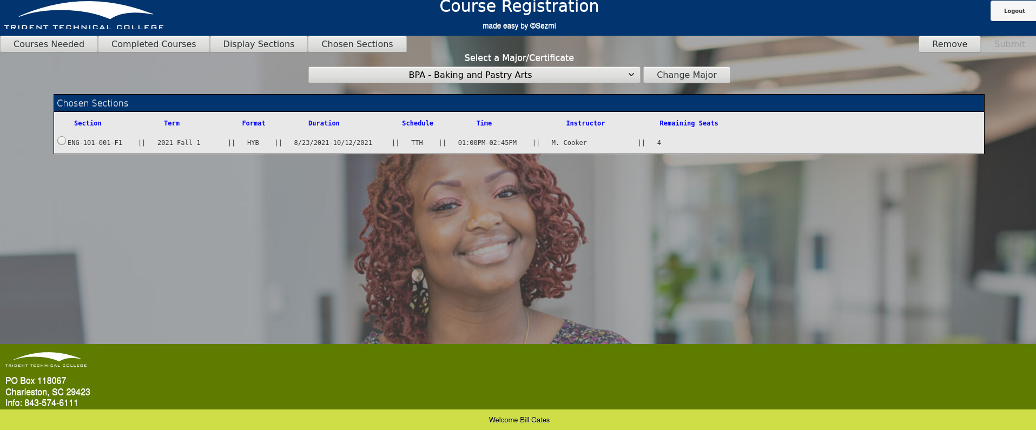
How it works
View sections enrolled in

Slide 20
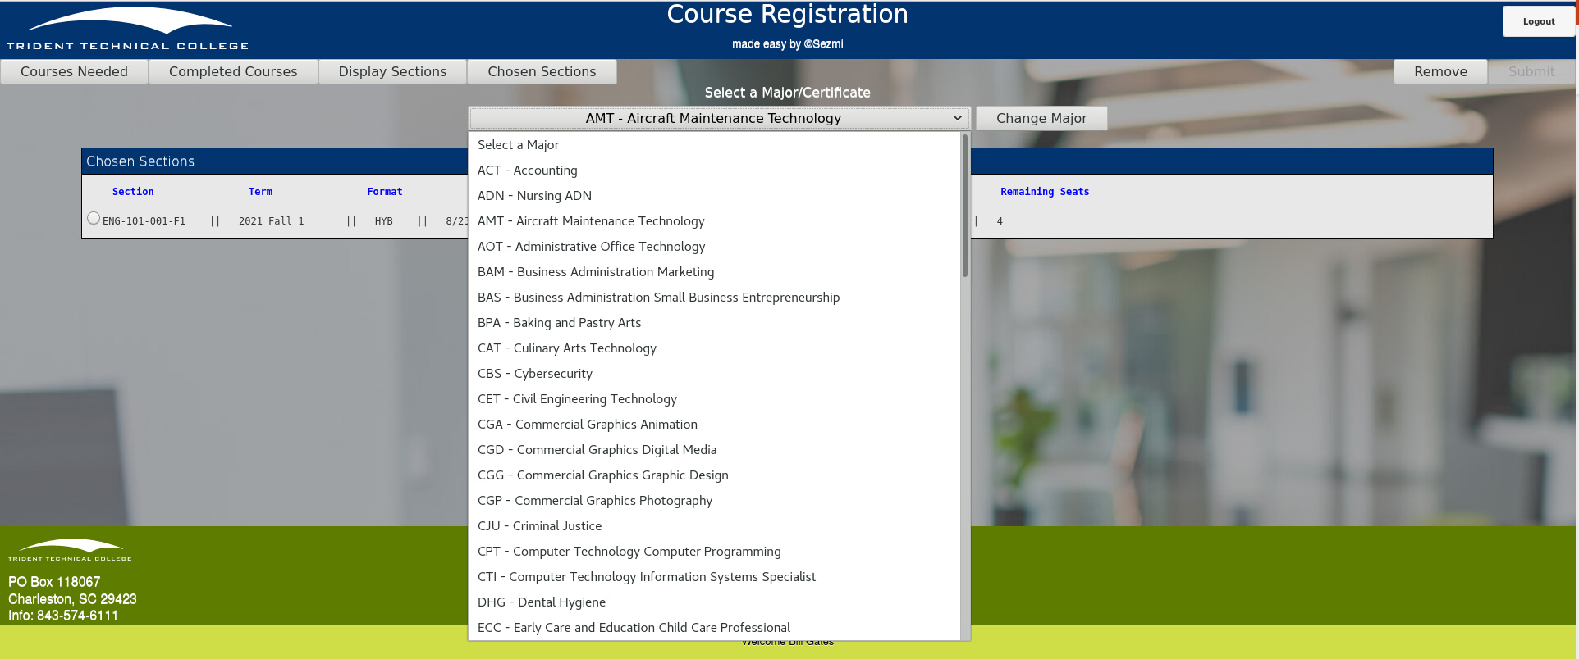
How it works
Changing your Major

Slide 21
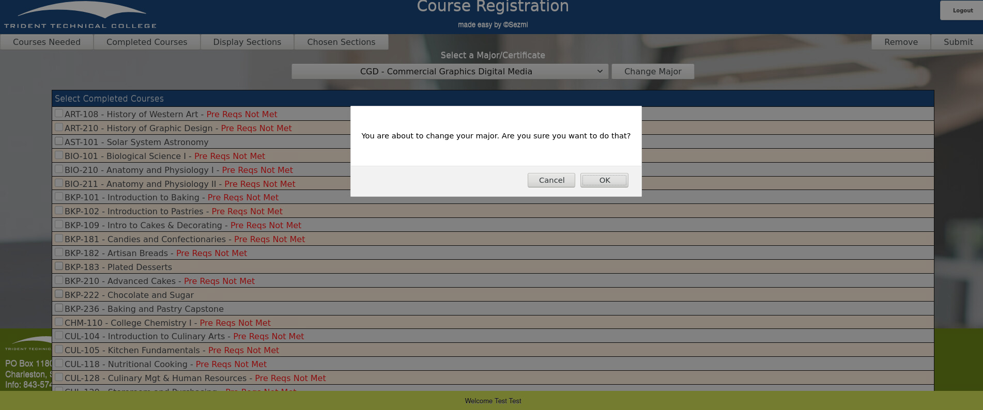
How it works
Changing your Major

Slide 22
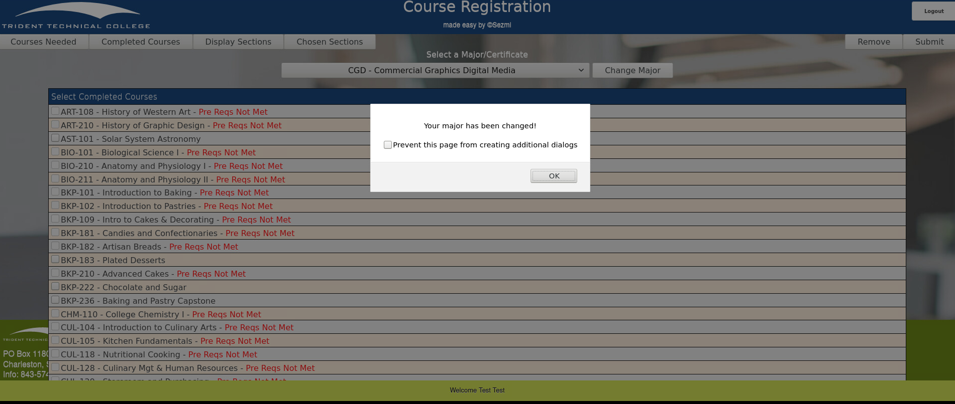
How it works
Changing your Major

Slide 23

Future Direction and changes
Admin privileges
Add a way to add a finished section to the completed courses list
Class Enrollment Email Confirmations
Search bar to find classes in Sections Available
Forgot Password confirmation email
Update Refreshing issues on site
Text Book Information
Optimize for Mobile Application

